Slide 1
Final Project
Yaoyi Bai

Slide 2
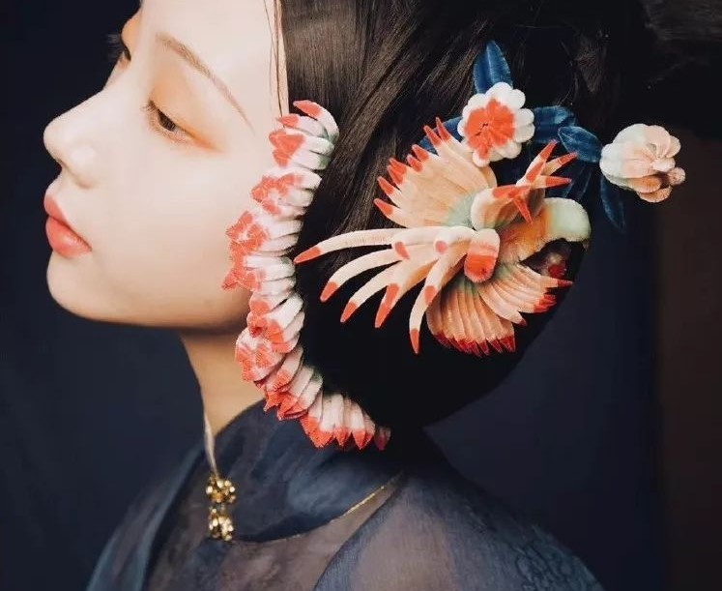
Inspiration: Velvet Flower: Traditional Hair Decoration
Velvet Flowers are made of metal wires that decide the shape of the flower, and the metal wires are covered with fluffy conture. It reflects ideas about repetition and generativity in physical world.

Slide 3
Concept and Motivation
Exploring the generativity ideas inside the physical world
Combining generativity and painting tools
Exploring the possibilities of converting physical art into digital art
Exploring a novel interpretation of traditional and cultural concepts

Slide 4
Overview
2D painting tool
Digital and modern interpretation of traditional art and design
Color gradient
Velvet width gradient
Customize color and velvet
Simple interface

Slide 5
Primary implementation challenges
The generativity feature of velvets: a lot of debugging tests were performed.
User interface: what parameters should be exposed? How should those parameters, like color gradient and velvet width, be calculated and reflected by those parameters?
How to make the painting result less dependent on moving speed of mouse or pencil?
Comparison with physical images: I tried to mimic the style of physical hair decoration.

Slide 6
Process
Generate velvets: calculate the slope of mouse motion and paint vertices beside mouse curves.
In case the user move too fast so that the velvets will not align with the mouse motion curve: paint vertices in draw function which does not depend on mouse moving speed
Create interface: add color wheels and sliders for parameters
Calculate color gradient and width gradient using slider inputs

Slide 7

Results

Slide 8
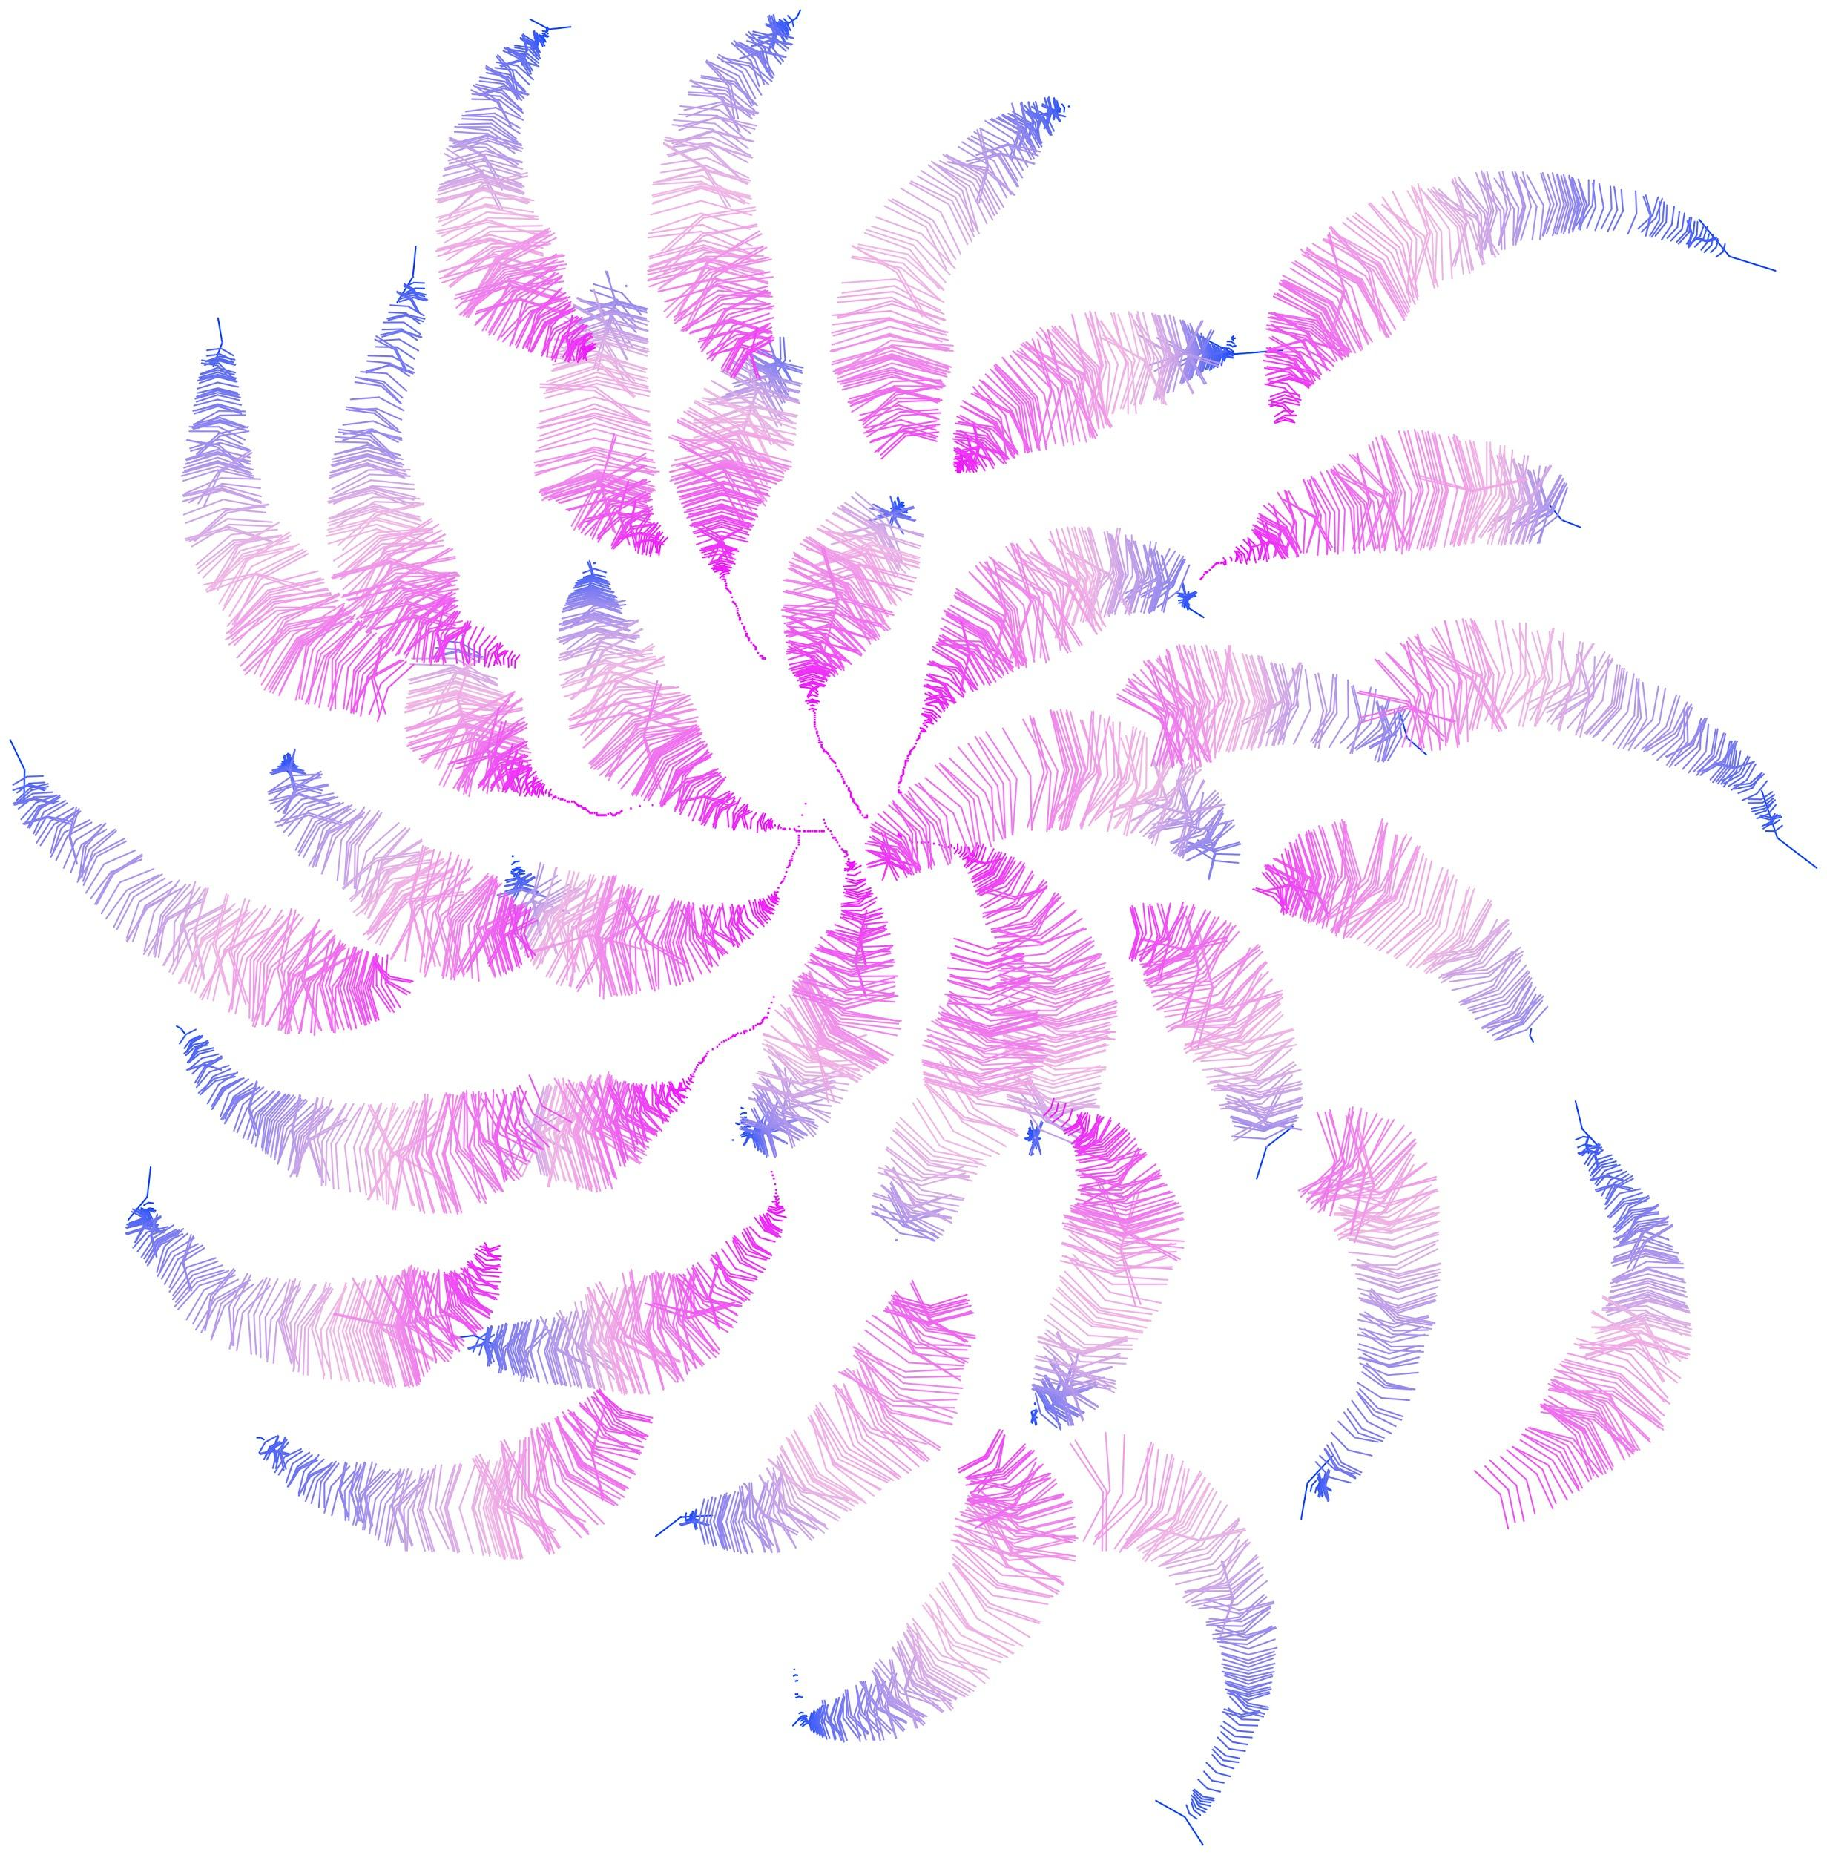
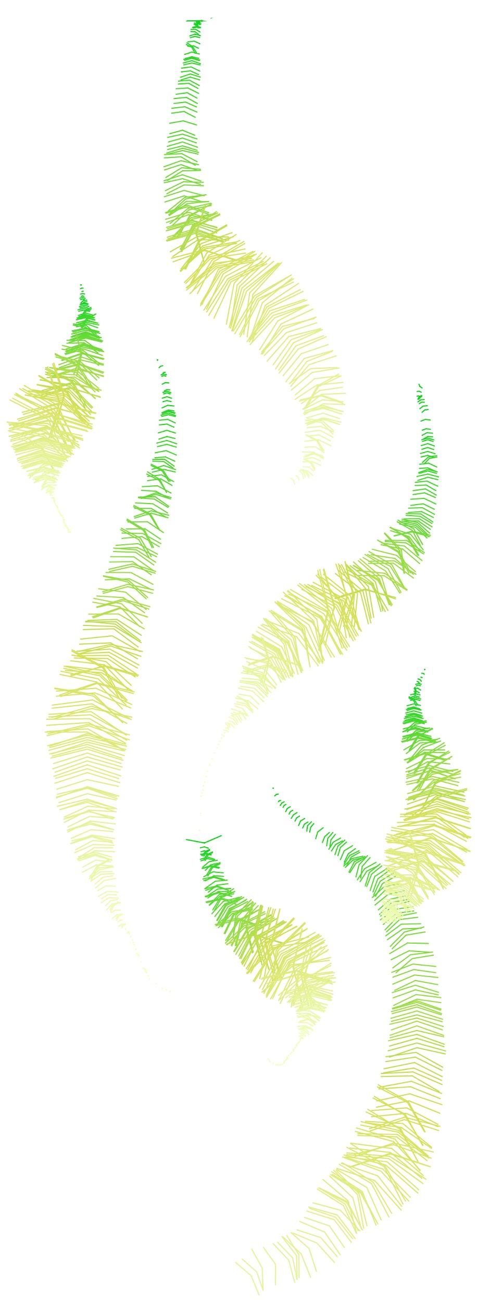
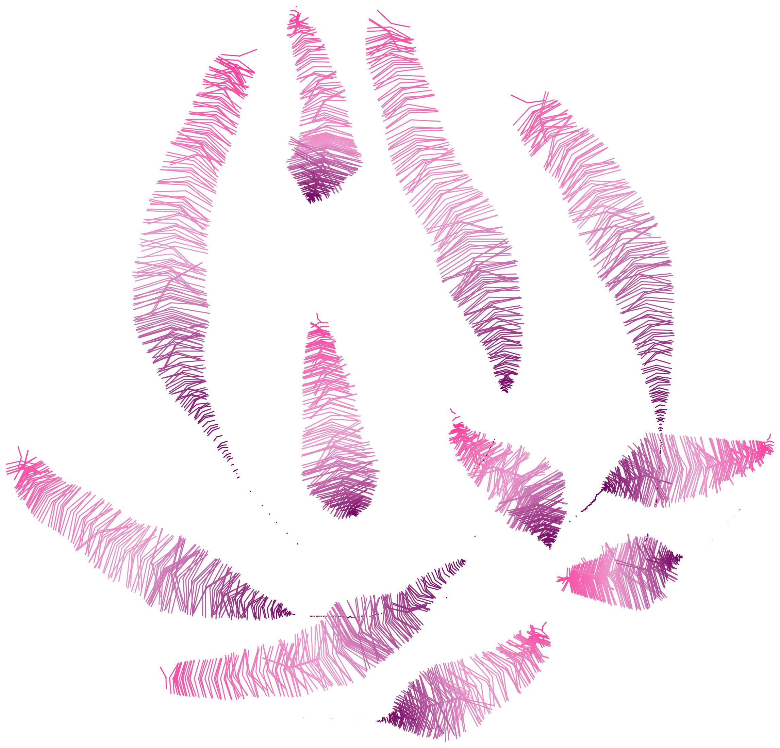
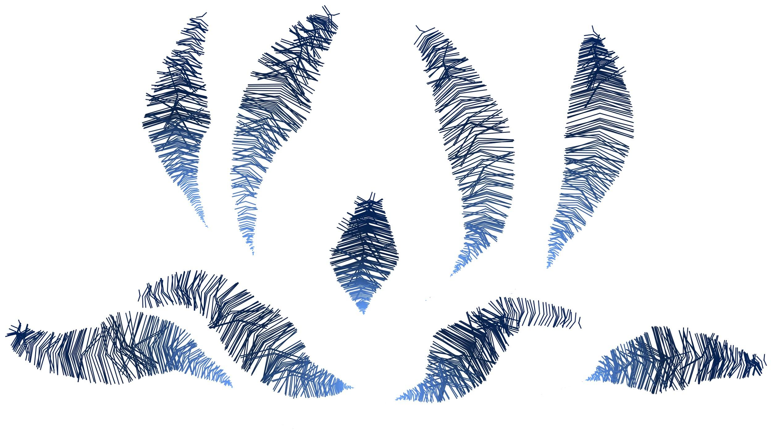
Results

Slide 9
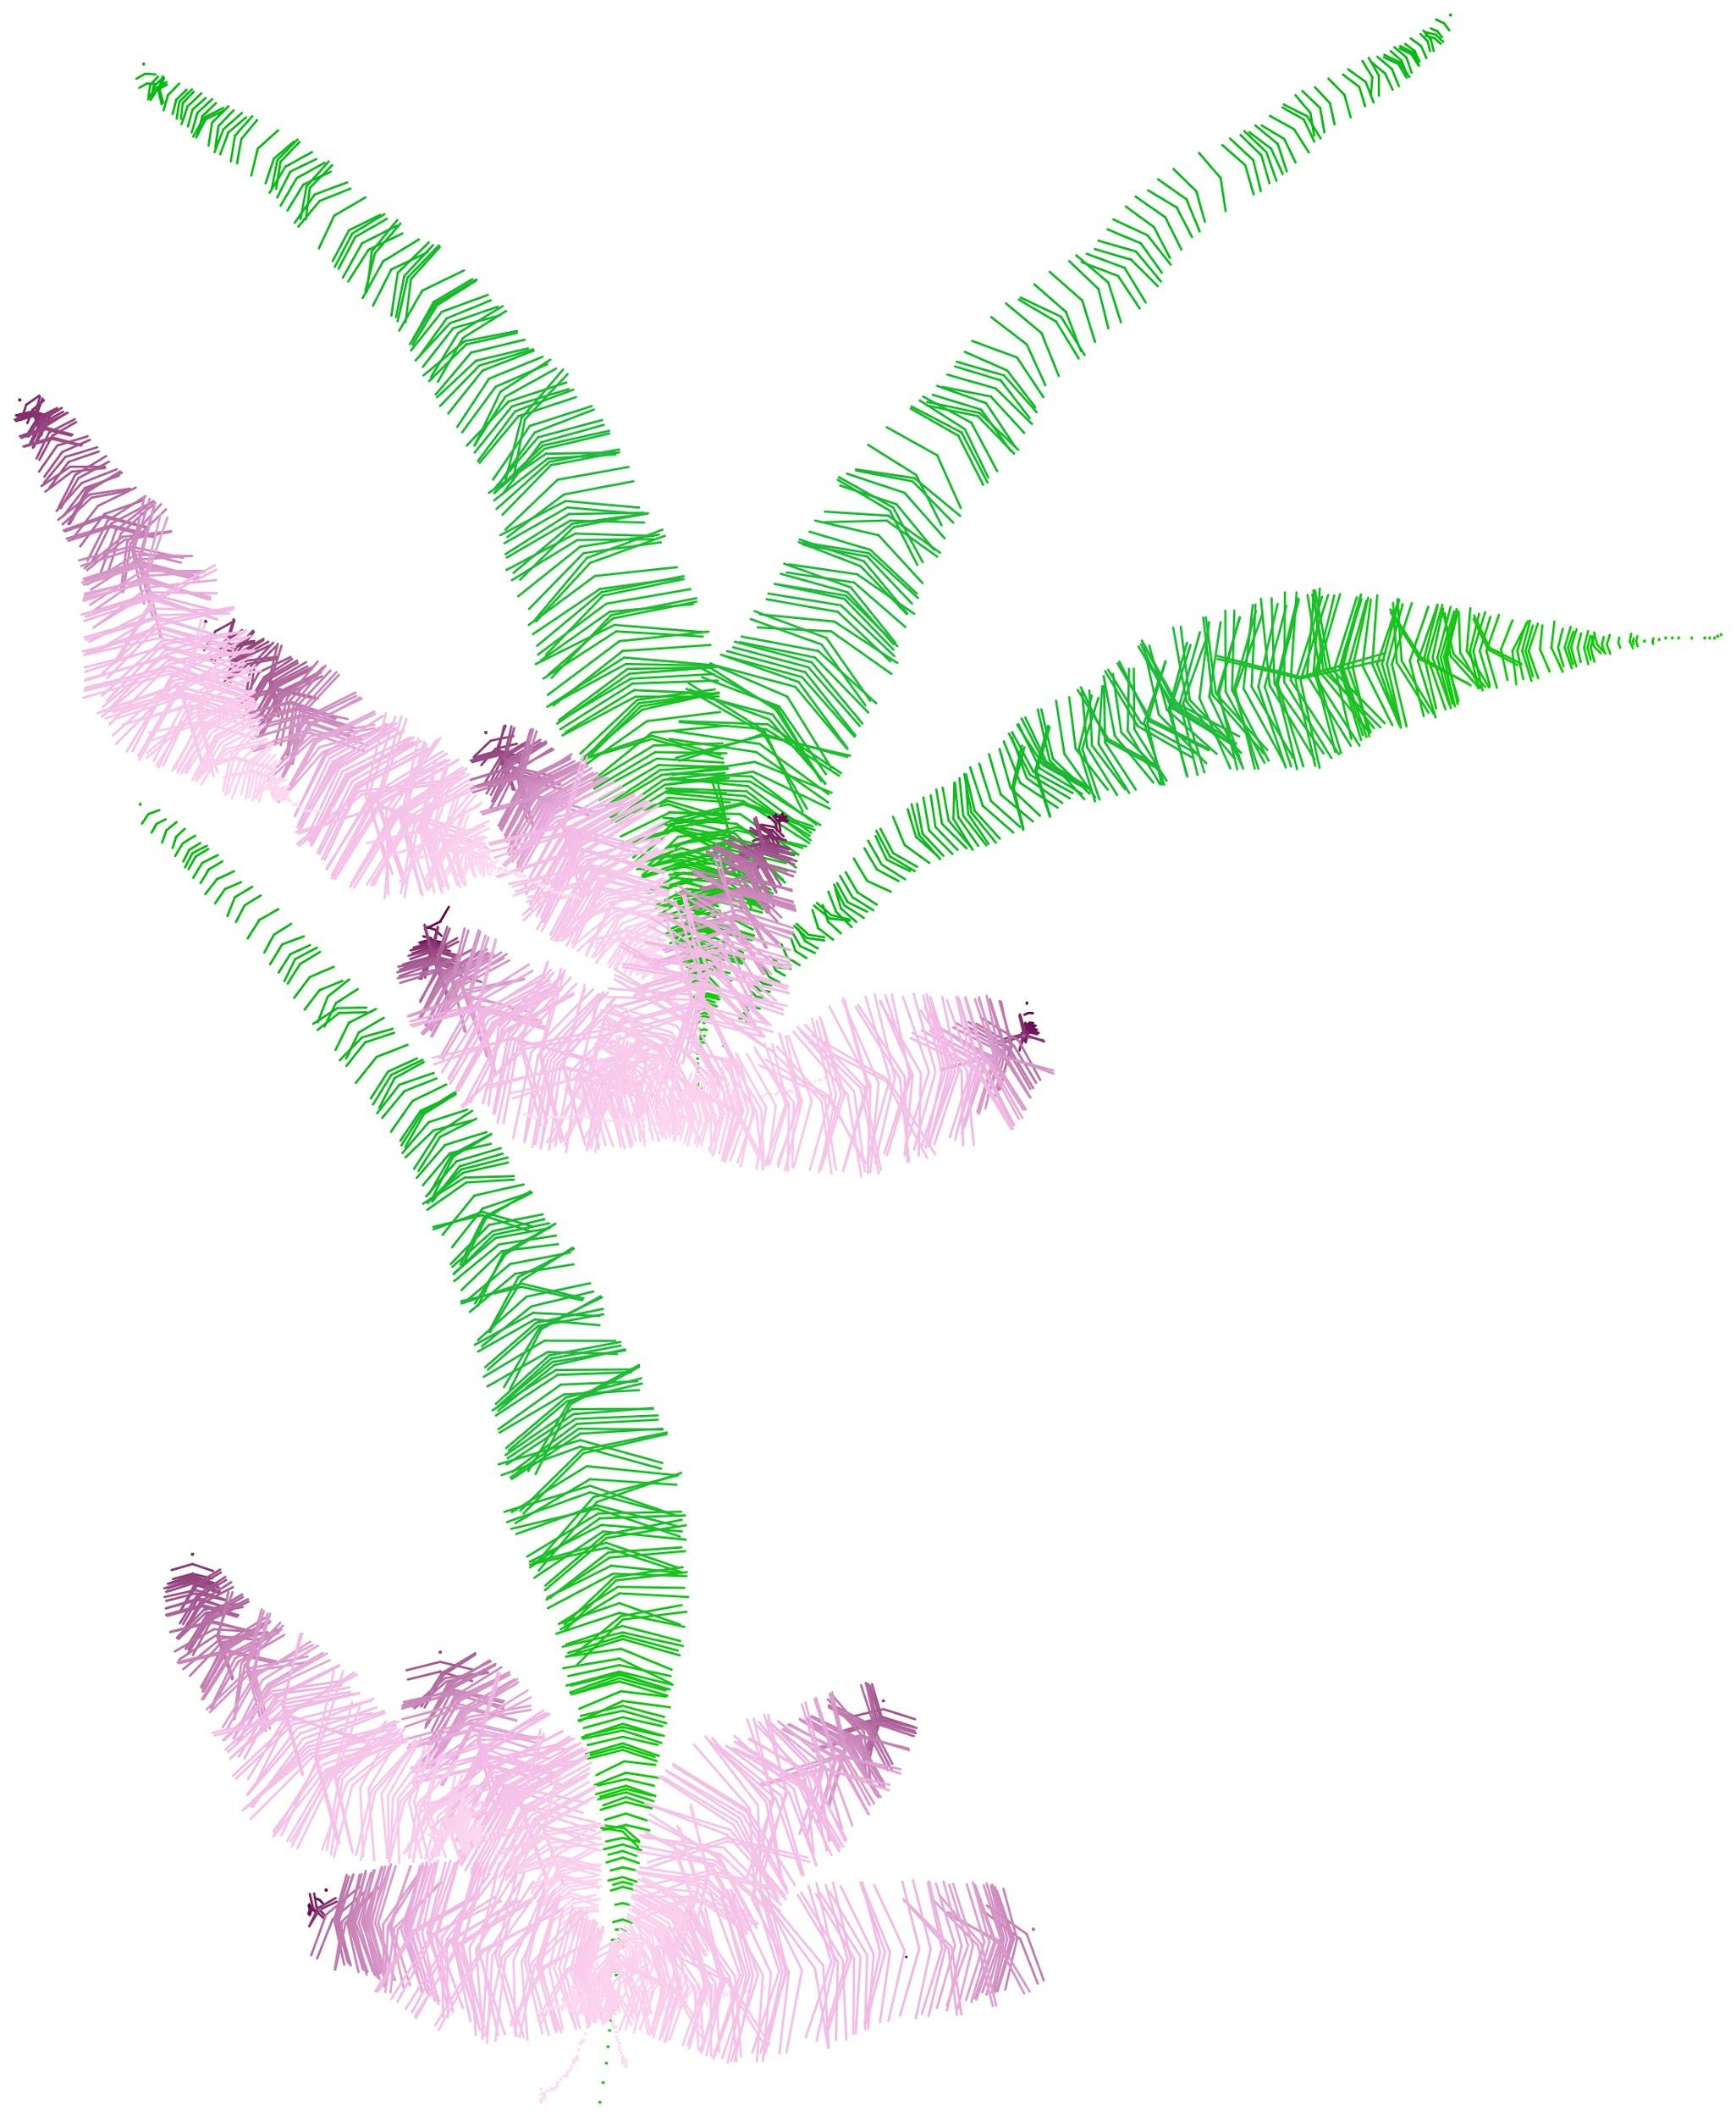
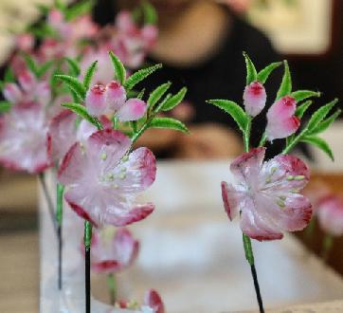
A Comparison Between Physical and Virtual

Slide 10
Future Implementation
Extend into 3D, shader and material rendering involved, research based projects?
Mathematical geometry or appearance modeling?
VR, AR and Unity engine involved for more digital display possibility in 3D?

